Slide 1
James A Robertson and Associates
Effective Strategic Business Solutions
Simple steps to increase the strategic value from your ERP investment
Live On-line Presentation (Webinar)
07 December 2012
Dr James Robertson PrEng
Copyright 2004 through 2012
James@JamesARobertson.com
Notes:
NB remember to have a chair to stand on
Make sure to take the CRITICAL FACTORS BOOK with you
An engineer with a PhD in engineering

Slide 2
Agenda
Make your ERP work for you
Most executives are FRUSTRATED
Why?
What to do?
What SMALL changes?
Unlocking the full potential

Slide 3
Agenda
Make your ERP work for you
Most executives are FRUSTRATED

Slide 4
One of the classic business problems of this age
We have spent a FORTUNE on this computer system and I.T. tell me it will take two years and another few million to get what I want BUT the transactions are being processed already

Slide 5
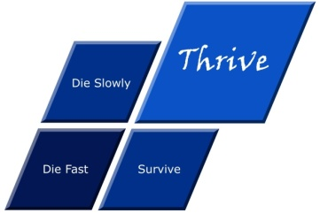
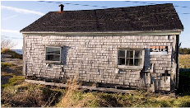
What is strategy?
Die fast
Thrive
Tactics – Doing things right ➔
Die slowly
Survive
Strategy – Doing the right things ➔
Professor Malcolm McDonald.

Slide 6
What IS Strategy?
The Essence of WHY the Organization exists and HOW it THRIVES

Slide 7
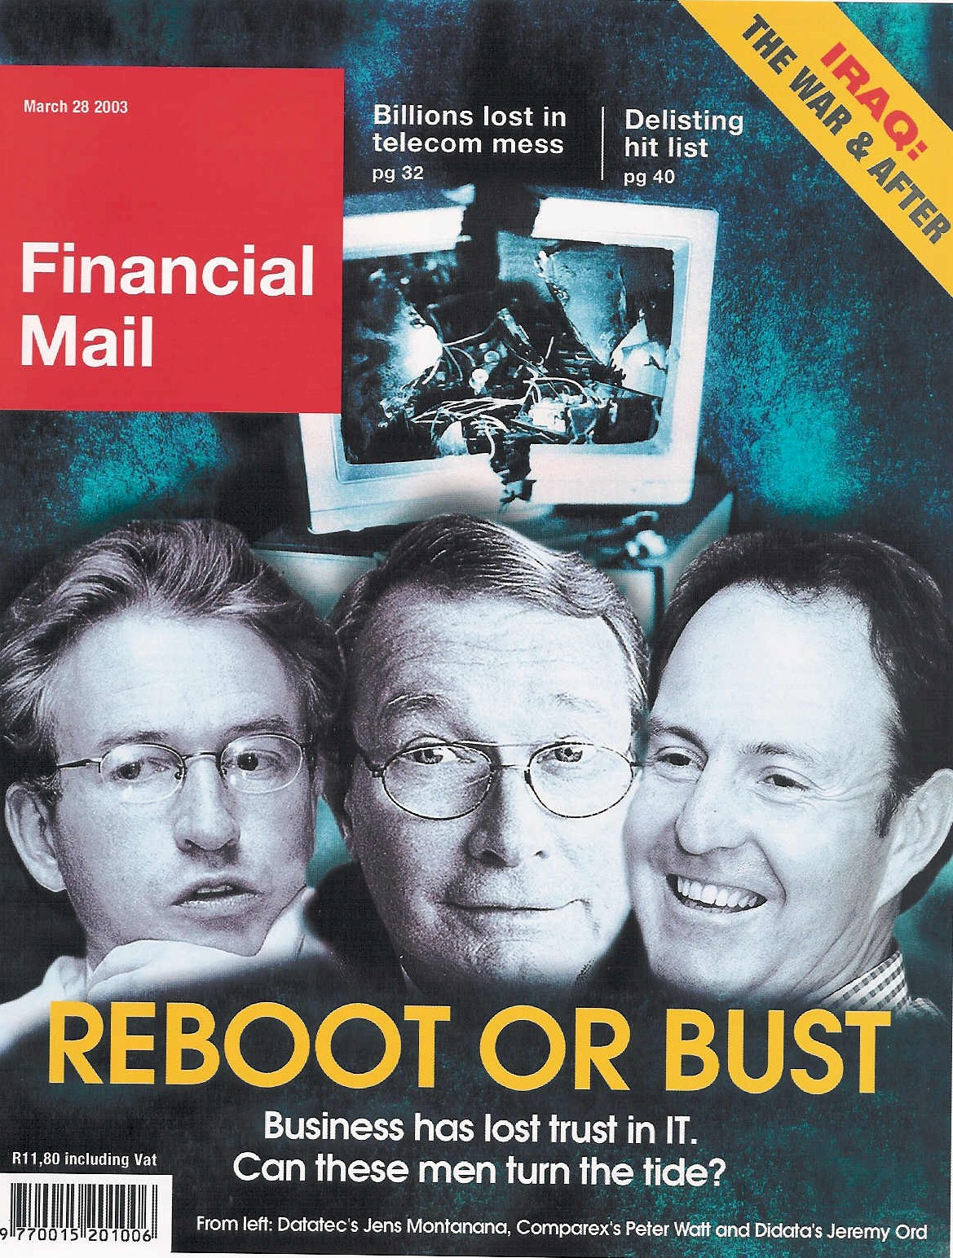
ERP an industry in crisis
“19 out of 20 ERP (integrated business information system) implementations do NOT deliver what was promised”
Notes:
An industry in Crisis -- Quote from Duncan McLeod, Financial Mail, 28 March 2008 -- Seven years and half a billion dollars -- Dow Chemicals Company -- $400 million – Nike -- Disney -- $878 million
-- 70% of business IT projects fail outright – another 20% materially fail to meet the business expectation – 70% of BPR projects fail and 90% of strategic plans fail to deliver

Slide 8
An industry characterized by failure
"Attendees of Gartner's Business Intelligence Summit in London last month were not surprised to hear that most enterprises are still failing to use business intelligence (BI) strategically. Gartner's survey of over 1300 CIOs returned some unimpressive findings about the state of BI implementations: Gartner's vice: president of research summed up the situation nicely by saying:
“Most organisations are not making better decisions than they did five years ago”
BUSINESS INTELLIGENCE
Article published in Computer Business Review Africa.

Slide 9
There IS great opportunity
ERP can and should add value
Notes:
Professor Richard Nolan states that "I.T. is the next corporate disaster waiting to happen”
And postulates that soon there will be an Enron level corporate failure
Do you remember Fedsure Health – tell the story SHORT

Slide 10
Agenda
Make your ERP work for you
Most executives are FRUSTRATED
Why?

Slide 11
Factors causing ERP failure
Weak content engineering is the most tangible factor causing failure

Slide 12
Factors for ERP reimplementation success
Strong content engineering is the most tangible factor for success

Slide 13
Agenda
Make your ERP work for you
Most executives are FRUSTRATED
Why?
What to do?

Slide 14
What is an ERP?
“Enterprise Resource Planning” = ERP Systems
? or ?
"Integrated Business Information Systems” = IBIS
= all the information “repositories”
= databases
= tables
= lists
= filing drawers / folders
real world items that require description and management
+ the numerical computations, workflow and other activities that are executed with the numbers (and text) stored in these repositories
ALL of which can be done by human beings -- including making a mess!

Slide 15
IBIS – what every company REALLY has ☺
Data warehouse and BI
Spreadsheets
Brandname ERP = FRED
Industry specific package
Etc, etc, etc
Custom-ization
In-house custom development

Slide 16
Conventional taxonomy example
ANIMALS
ELEPHANTS
RHINOCEROS
DOGS
CATS
LIONS
LEOPARDS
DOMESTIC CATS
Persian Cats
Domestic Short Hair Cats
etc

Slide 17
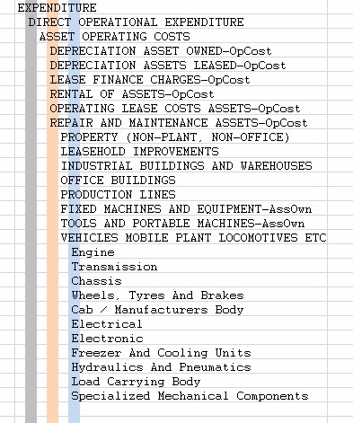
Taxonomy defined
Logical word (semantic structure)
Precision vocabulary of preferred terms
Conveys understanding between humans with relevant knowledge and experience
Once linked to a precision code scheme the most important communication mechanism between computers and people
An art and a science
Once it is right it is OBVIOUS ☺

Slide 18
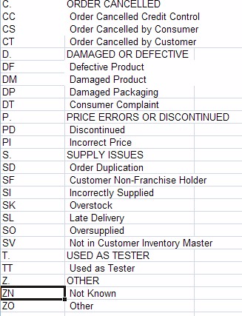
Taxonomy relevance
Essential to effective operational and strategic use of business software
Nearly ALL validation lists (drop down lists), chart of accounts, etc
Large body of expertise – Botany, Zoology, military filing, Library Science, Information Management, etc
Unknown to many (most?) IT professionals and business people

Slide 19
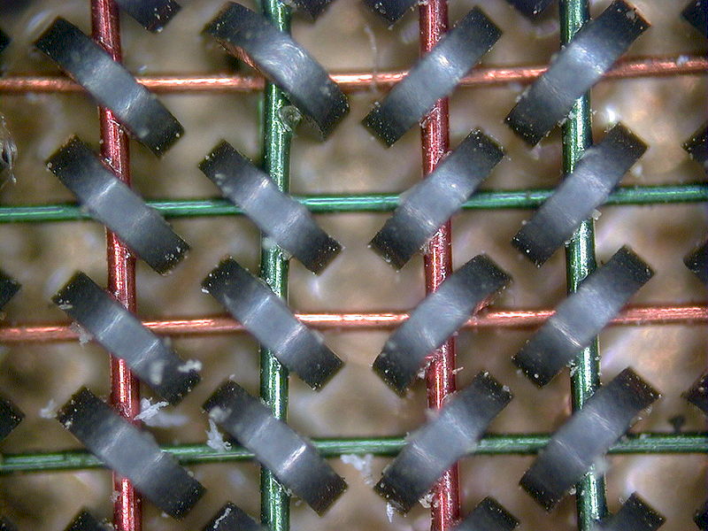
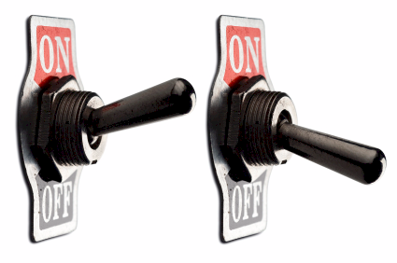
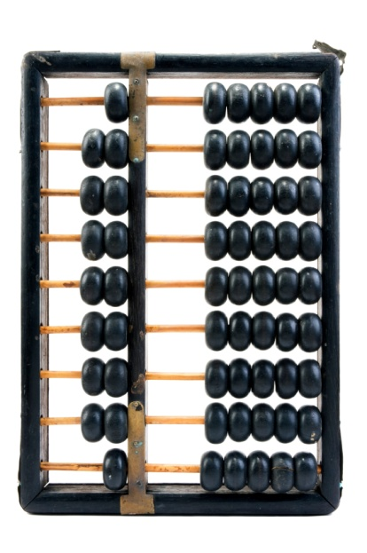
A computer is
An adding machine / calculator
0
1
1+1=10
1+1+1=11
1+1+1+1=100
Called a “bit”
8 bits make a byte
2 bytes make an ASCII character
A= “41” hex
0
1
Notes:
DHL, Prochem,

Slide 20
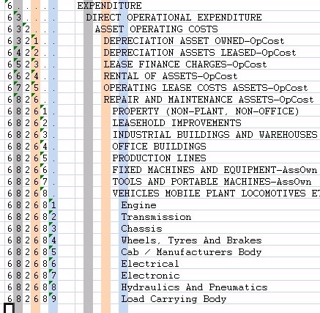
Coding taxonomies
Computers only understand binary
The code is a unique binary pattern that corresponds to the structured language taxonomy
The only way the computer will appear to be intelligent
Results in “intelligent data”
Standard conventions
Indents and trailing periods
2. Capitalization
3. Other standards and conventions

Slide 21
Taxonomy examples
Some practical examples of how code schemes should look
Various small validation lists – some custom, some standard
Various custom product attributes
Product classification – custom field
Machine vehicle operating costs and spares
Consolidation Charts of Accounts medium and large organizations

Slide 22
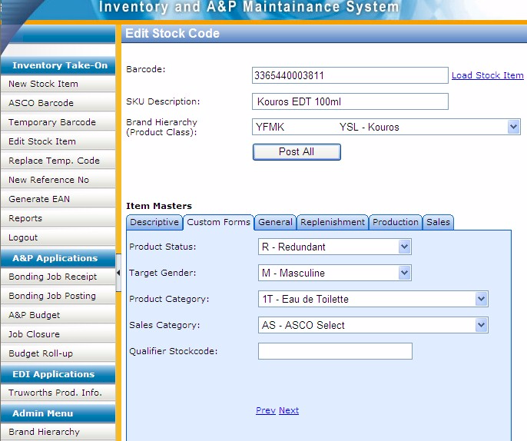
Example of custom data entry screen
With custom taxonomies
Notes:
DHL, Prochem,

Slide 23
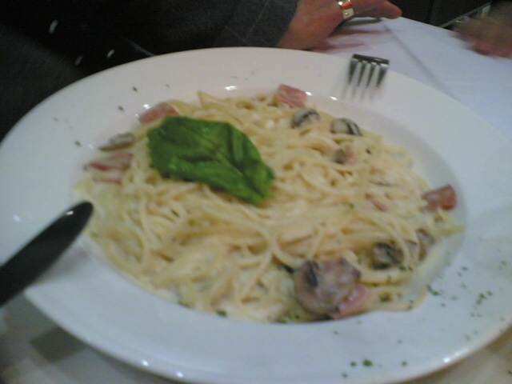
Example of exceptionally BAD practice
Huge impact on integration, reporting, etc
500528 | Waste Material Consumed
500530 | Loss from valuation of external materials
500540 | Loss from valuation of own materials
500550 | Losses - inventory variance -consignment sale
500560 | Safety Clothing
500565 | Safety Equipment
500570 | Sand & Stone
500575 | Scraper Rope
500580 | Scrapers
500585 | Services
500590 | Signs
500595 | Skips & Cages
500600 | Finished Goods Inventory Offset
500605 | Smelting & Refining
500610 | Production Order Settlement - Variance
500615 | Steel Other
500620 | Steel Sections
500625 | Steel Sheets & Plates

Slide 24
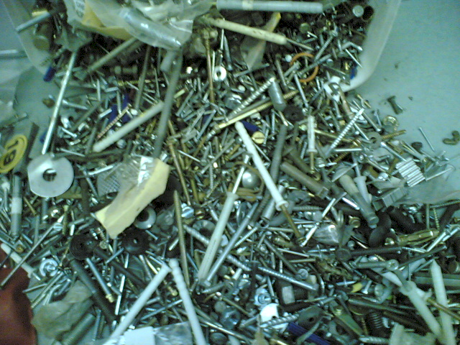
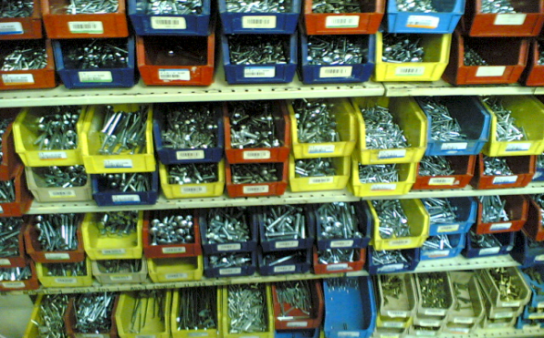
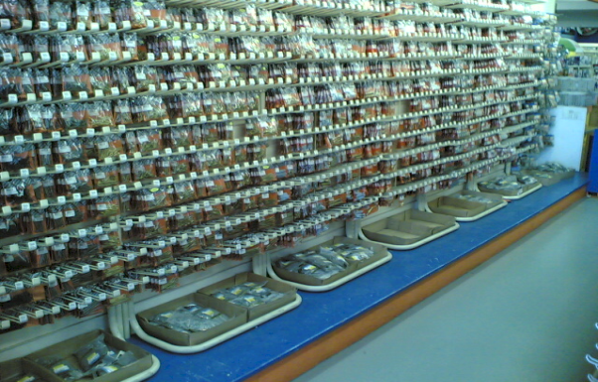
Precision ordered data
Versus …

Slide 25
Value versus precision
A critical consideration
The goal
100%
Business value delivered
Just about every implementation I have ever seen
Practical fundamental strategic taxonomy precision
100%

Slide 26
Critical principle – constraint and opportunity -- cognitive span
Strategically determined (thrive) segmentation

Slide 27
Drill down
A function of the content
Strategically determined (thrive) segmentation

Slide 28
The fundamental requirements for an ERP
The answers to questions I have not yet thought to ask
Enable me to run the business MY way
Accurately model every aspect of my business
Totally integrated solution
Entirely reliable and dependable
Fundamentally support the essence of the business and how it thrives (strategy)
Fully support my day to day operational functions

Slide 29
What can be done?
Buy a new ERP – expensive, high risk
Re-implement your current ERP – not quite as expensive
Comprehensive Data Warehouse with Precision Taxonomies – not nearly as expensive or high risk but still costly
Anything else? -- SMALL changes?

Slide 30
Agenda
Make your ERP work for you
Most executives are FRUSTRATED
Why?
What to do?
What SMALL changes?

Slide 31
How is value created
Value is created by business actions that deliver on the essence of why the organization exists and how it thrives
Value manifests through increased profitability, growth, acquisitions, job satisfaction, fulfilment of the strategic vision
The consequence of intuitive, intelligent, informed leadership business decisions – thrive decisions
Such decisions are facilitated, accelerated and enhanced through access to more intelligent, meaningful and relevant information
Answers to the questions I have not yet thought to ask
Such “intelligent information” is assembled as a consequence of high level strategic and executive level input into the design of the data CONTENT – taxonomies designed to catalogue every conceivably relevant classification ahead of time
High value intelligent content design

Slide 32
Agenda
Make your ERP work for you
Most executives are FRUSTRATED
Why?
What to do?
What SMALL changes?
Repopulate key standard attribute tables
Create new custom attribute tables

Slide 33
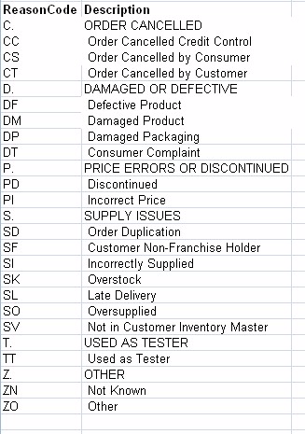
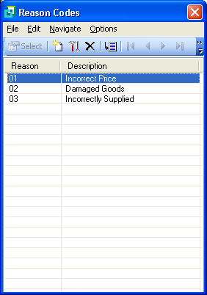
A simple high value example – Credit Note Reason Codes
Example of poor credit note reason codes – actual case
Strategically aligned credit note reason codes
Drastically improve the content of some key tables such as Credit Note Reasons, Product / Item Class, etc

Slide 34
Develop lists
One to ten people in a room with a projector
Brainstorm all possible content for the list – capture on screen
Each summarize to between five and ten headings
Type all the lists in
Combine them into between five and ten groups
Give each group a heading
Lift out sub-categories
Code – remember indents, trailing periods, capitalization
Check impacts
Implement

Slide 35
Develop lists 2
Quality of list is dependent on quality of input
Want lists to be complete, comprehensive and well designed
Design compromises will be with you for ever
Document
Train
Utilize

Slide 36
Develop lists 3
Develop Hierarchy
Hierarchy of descriptions – indent each level by one character position
HEADINGS IN CAPITAL LETTERS
Posting level items in Proper Case
Abbreviate as necessary
Code
Mirror indents with trailing periods
Gap code
Mnemonic Alpha preferred, else Alpha Numeric, else Numeric
1 to 4 character segments separated by “-”

Slide 37
Agenda
Make your ERP work for you
Most executives are FRUSTRATED
Why?
What to do?
What SMALL changes?
Repopulate key standard attribute tables
Create new custom attribute tables

Slide 38
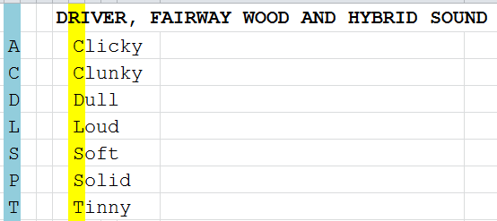
A simple high value example – Product Attributes
Add user defined attribute fields anywhere where they make sense – Products, Debtors (Customers), etc

Slide 39
Develop attributes
One to ten people in a room with a projector
Brainstorm all possible attributes for management information
If in doubt add
Structure and Code as before
Capture sheets
Train staff to classify and add
Reports
Identify clever functionality that can work with attributes, add where cost effective
Harvest information

Slide 40
Agenda
Make your ERP work for you
Most executives are FRUSTRATED
Why?
What to do?
What SMALL changes?
Unlocking the full potential

Slide 41
Unlocking the full potential
Progressively improve classifications and add attributes
Progressively develop reports, analysis and custom functionality
Advance to more complex and inter-related lists:
Product / Item / Material Class / Group is the largest list that you might apply this approach to
Major Master Lists like Chart of Accounts and Product Catalogue / Master might be done in increments ONCE you have experience with this approach
Other Master Lists like Debtors and Creditors Masters could be restructured in time
Eventually you might find you have effectively re-implemented

Slide 42
Summing up
Better DECISIONS
Excellent high value decisions rely on logical strategically aligned information → the information to thrive
To get executive intelligence OUT you must put executive intelligence IN – “intelligent content”
Precision strategic content engineering IS THE missing link in ERP and IBIS
Some items require a very small investment – an ART and a science
A significant opportunity to get more out of your current systems

Slide 43
If you do not act within 48 hours you probably never will – act TODAY! ☺
What is your single most important insight from this presentation?
What is the single most practical action that you can take tomorrow to apply I.T. more effectively?
Please write down your thoughts
NOW
James@Webinars-at-JARA.com

Slide 44
Questions?
We will email you my book, hand-outs and
link to the recording of this presentation
JAR&A are available to assist in applying these principles
"To Him who by wisdom made the heavens, for His mercy endures forever;"
James Robertson -- Mobile: +27-(0)83-251-6644
www.James-A-Robertson-and-Associates.com
James@JamesARobertson.com
LinkedIn: http://za.LinkedIn.com/in/DrJamesARobertsonERPDoctor
Assisting clients to thrive through the effective application of IT and ERP

